Slide 1
Overview of Justice Forward
Where We’ve Been and Where We’re Going

Slide 2
Our Mission
Justice Forward breaks the cycle of incarceration by funding essential programs for individuals in the Harris County and Galveston County Specialty Courts to help them become independent and productive members of our community.

Slide 3
Specialty Courts in Harris County
There are 18 Specialty Courts in Harris County located in the criminal, family and juvenile courthouses.
Adult Courts include:
  4 Drug Courts
  2 Veterans Courts
  2 Mental Health Courts
  5 D.W.I. Courts.

Slide 4
Specialty Courts in Harris County
Juvenile Courts include:
  Anti-Human Trafficking Court (CARE Court)
  Anti-Gang Court (GRIP Court)
  Drug Court (SOAR Court)
  Mental Health Court (360° Court)
Family Court has its own Drug Court to assist in family reunification when substance use disorder is present in the family. (Positive Pathway)

Slide 5
Galveston County Courts:
H.O.P.E. Drug Court
Felony Mental Health Court

Slide 6
Organizational History
In 2003, the organization was founded by members of Emerson Unitarian Universalist Church.
In 2006, it was incorporated as an independent, tax-exempt nonprofit as Harris County Drug Court Foundation
The organization was led by a volunteer Board of Directors with no staff and no operational budget.

Slide 7
Capacity Building
In 2018, the Board of Directors decided it could do much more to help individuals in Harris County Specialty Courts and began a capacity building campaign.
In 2019, the organization
  Established an annual operating budget.
  Began a fundraising program.
  Hired its first President/CEO.

Slide 8
Expansion
By early 2020, the organization expanded support to all 18 Harris County Specialty Courts by signing MOUs with the directors of the Adult and Juvenile CSCD Directors, as well as the Family Court judge.
How to structure and process requests from 18 courts?

Slide 9
Courts Alliance Council (CAC)
Comprised of a representative for each group of Specialty Courts for a total of 7 members
Responsibilities:
    Meet with the Justice Forward team quarterly
    Provide reports to the Board of Directors
    Submit requests on behalf of the clients
    Keep a log of all assistance received throughout the year
    Provide data upon request

Slide 10
Organizational Chart
Board of Directors
President and Chief Executive Officer
Court Alliance Council (CAC)
Admin Assistant
18 Harris County Specialty Courts
2 Galveston County Specialty Courts
Program Director
Clients & Graduates
Clients & Graduates

Slide 11
Processing Requests
CAC Assistance Request Forms
Client Online Request Forms
Monetary Thresholds

Slide 12

New Brand and Tagline

Slide 13
Areas of Assistance
Transitional Housing
Counseling
Transportation
Incentive Gift Cards
Tuition Assistance/Scholarships
Emergency Assistance

Slide 14
The Shift To Programming
Kids Moving Forward
Clear Path Forward

Slide 15

2022 Programs

Slide 16










The Partners

Slide 17

Sober Chili Cookoff

Slide 18
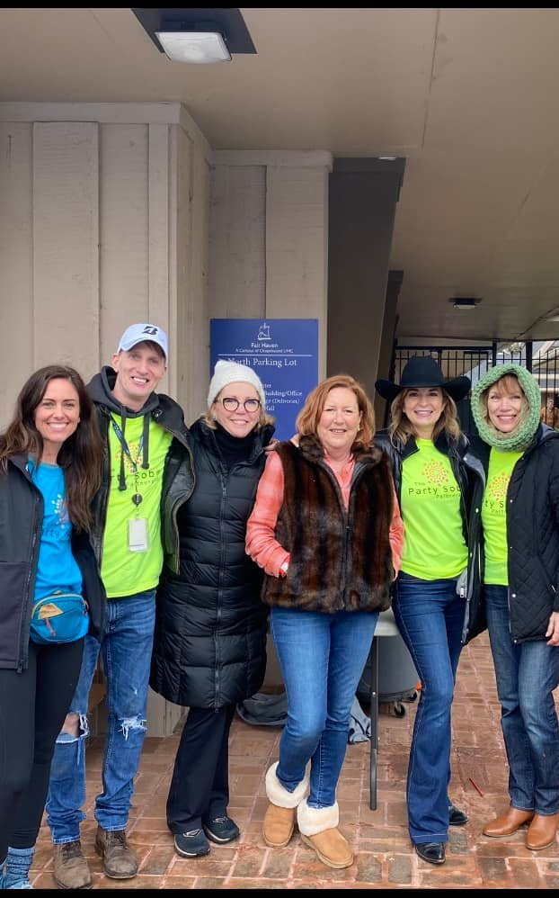

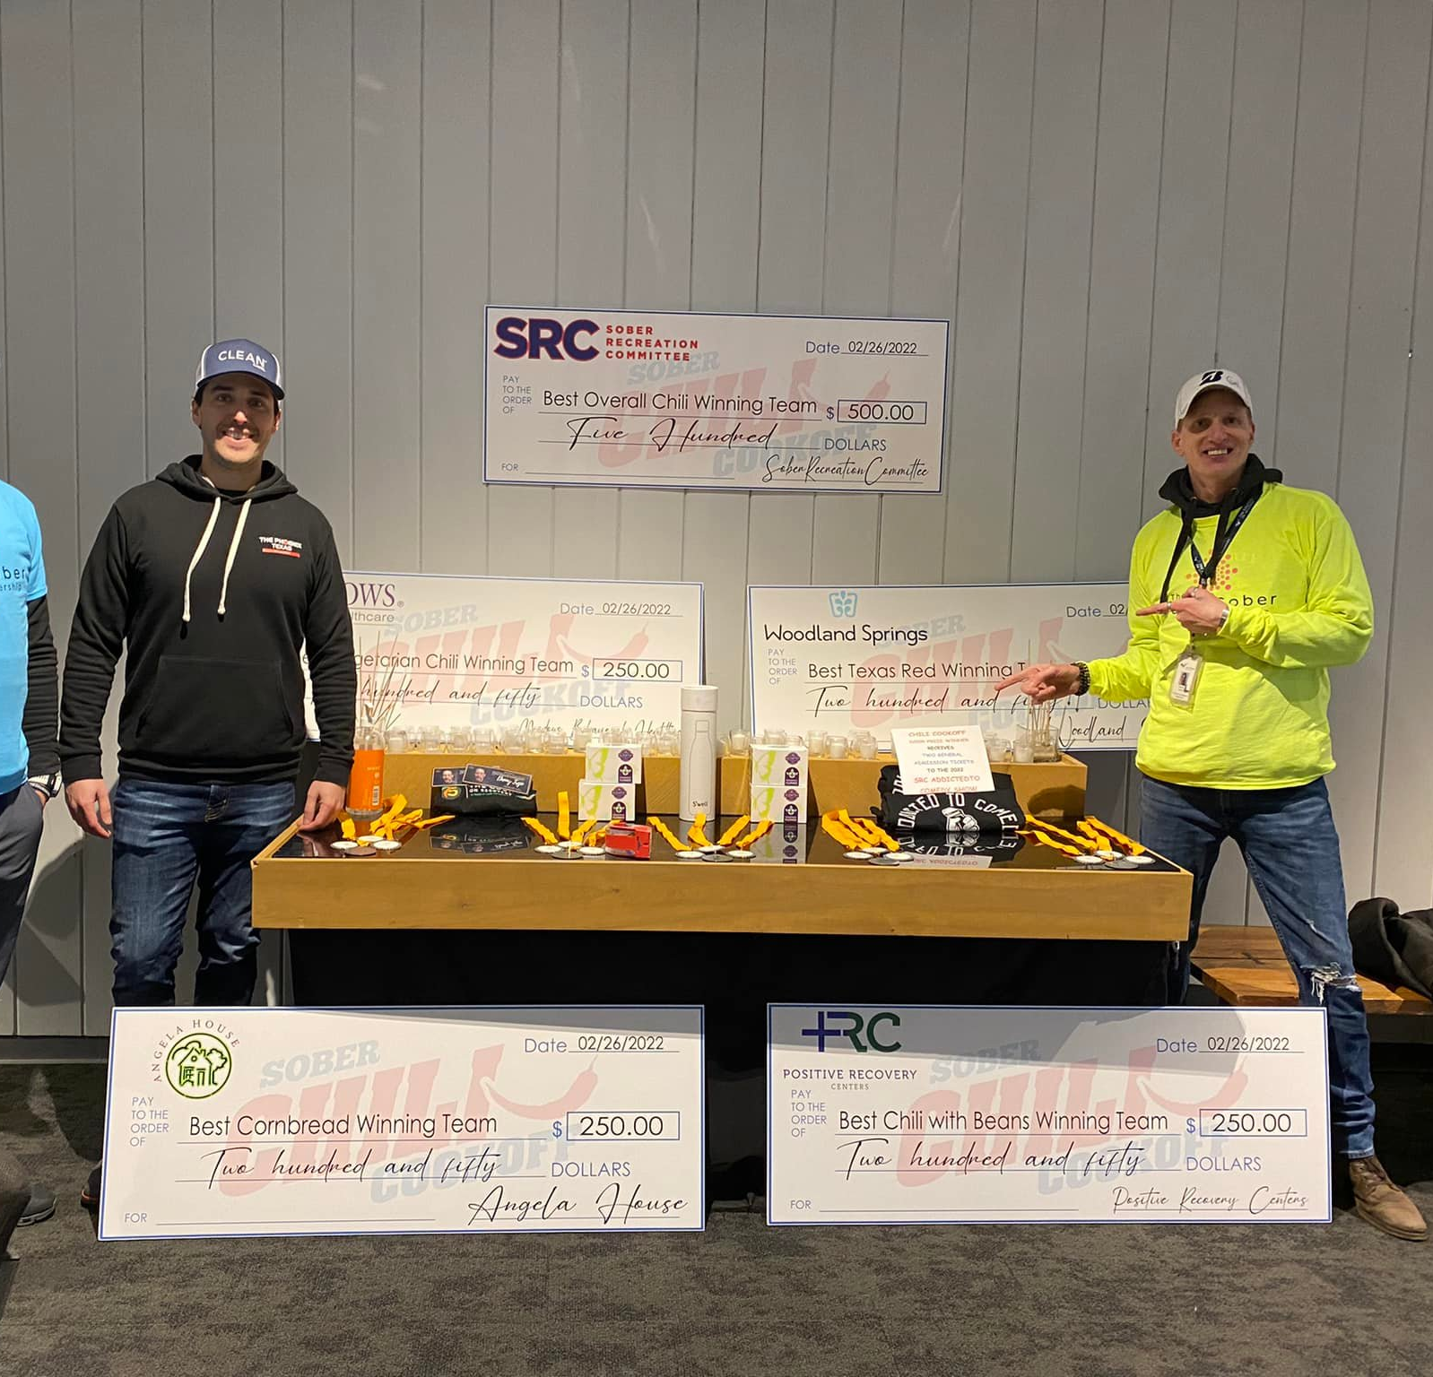

Slide 19
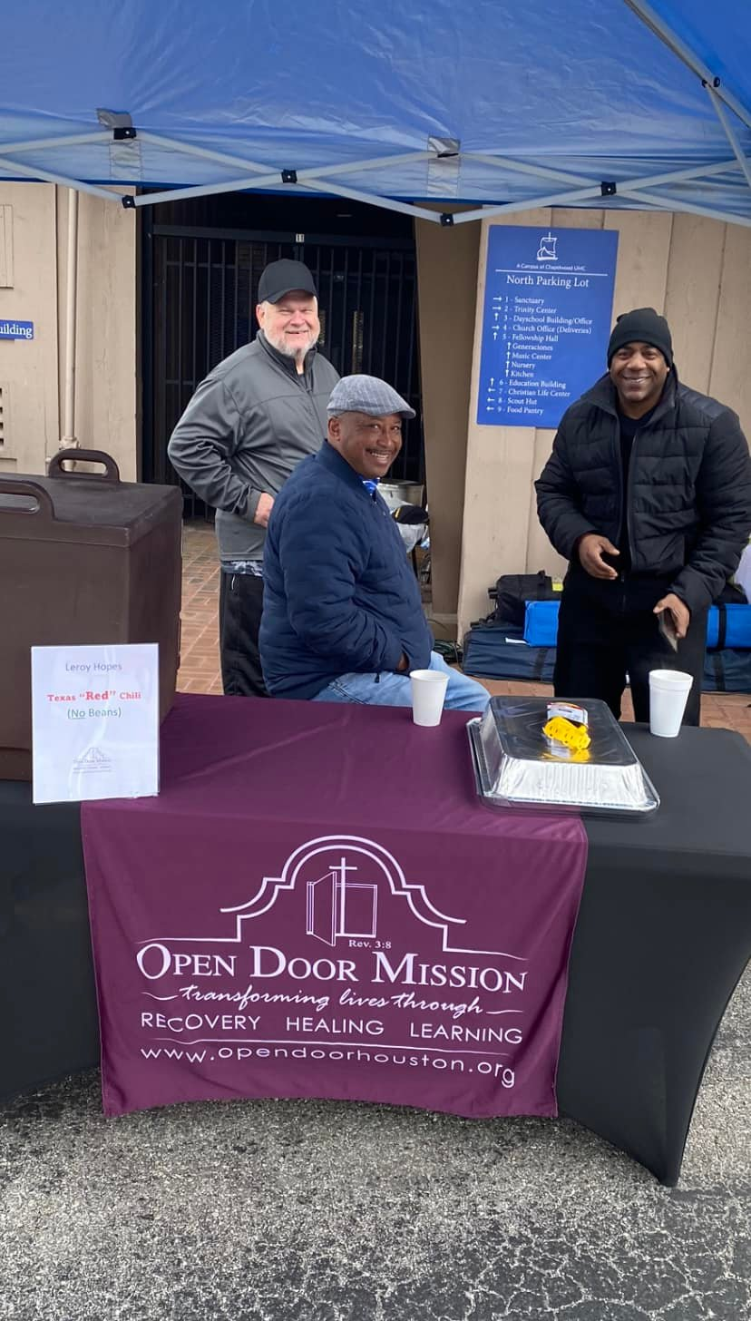
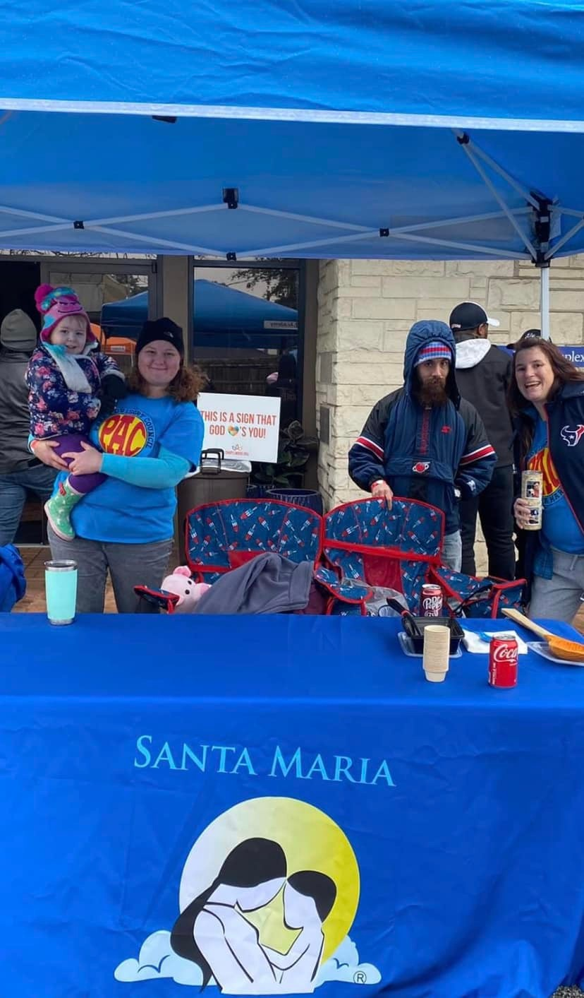
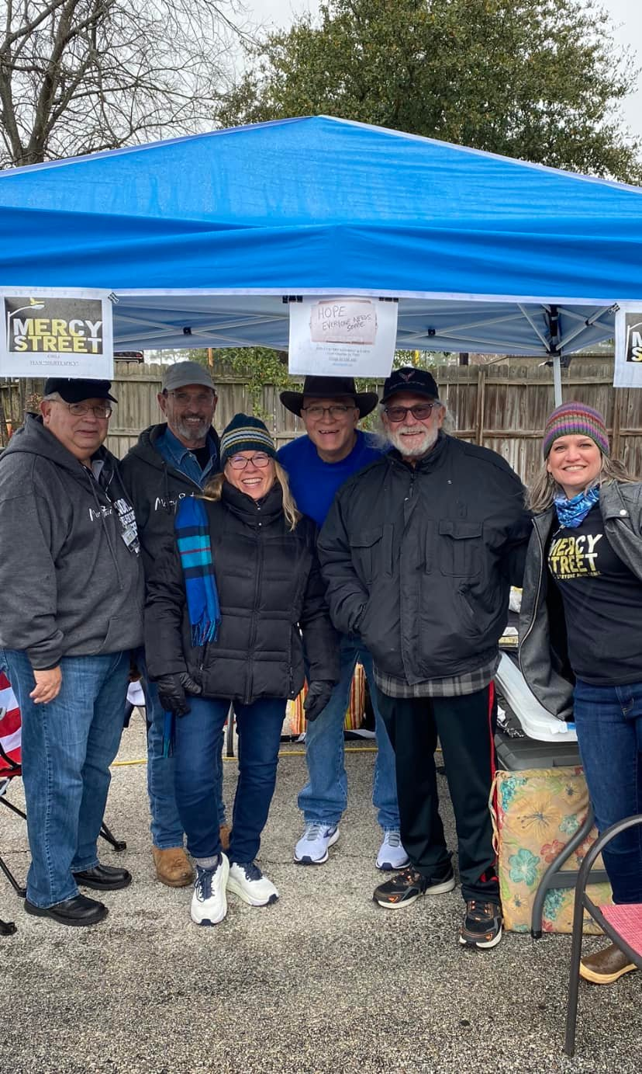

Slide 20
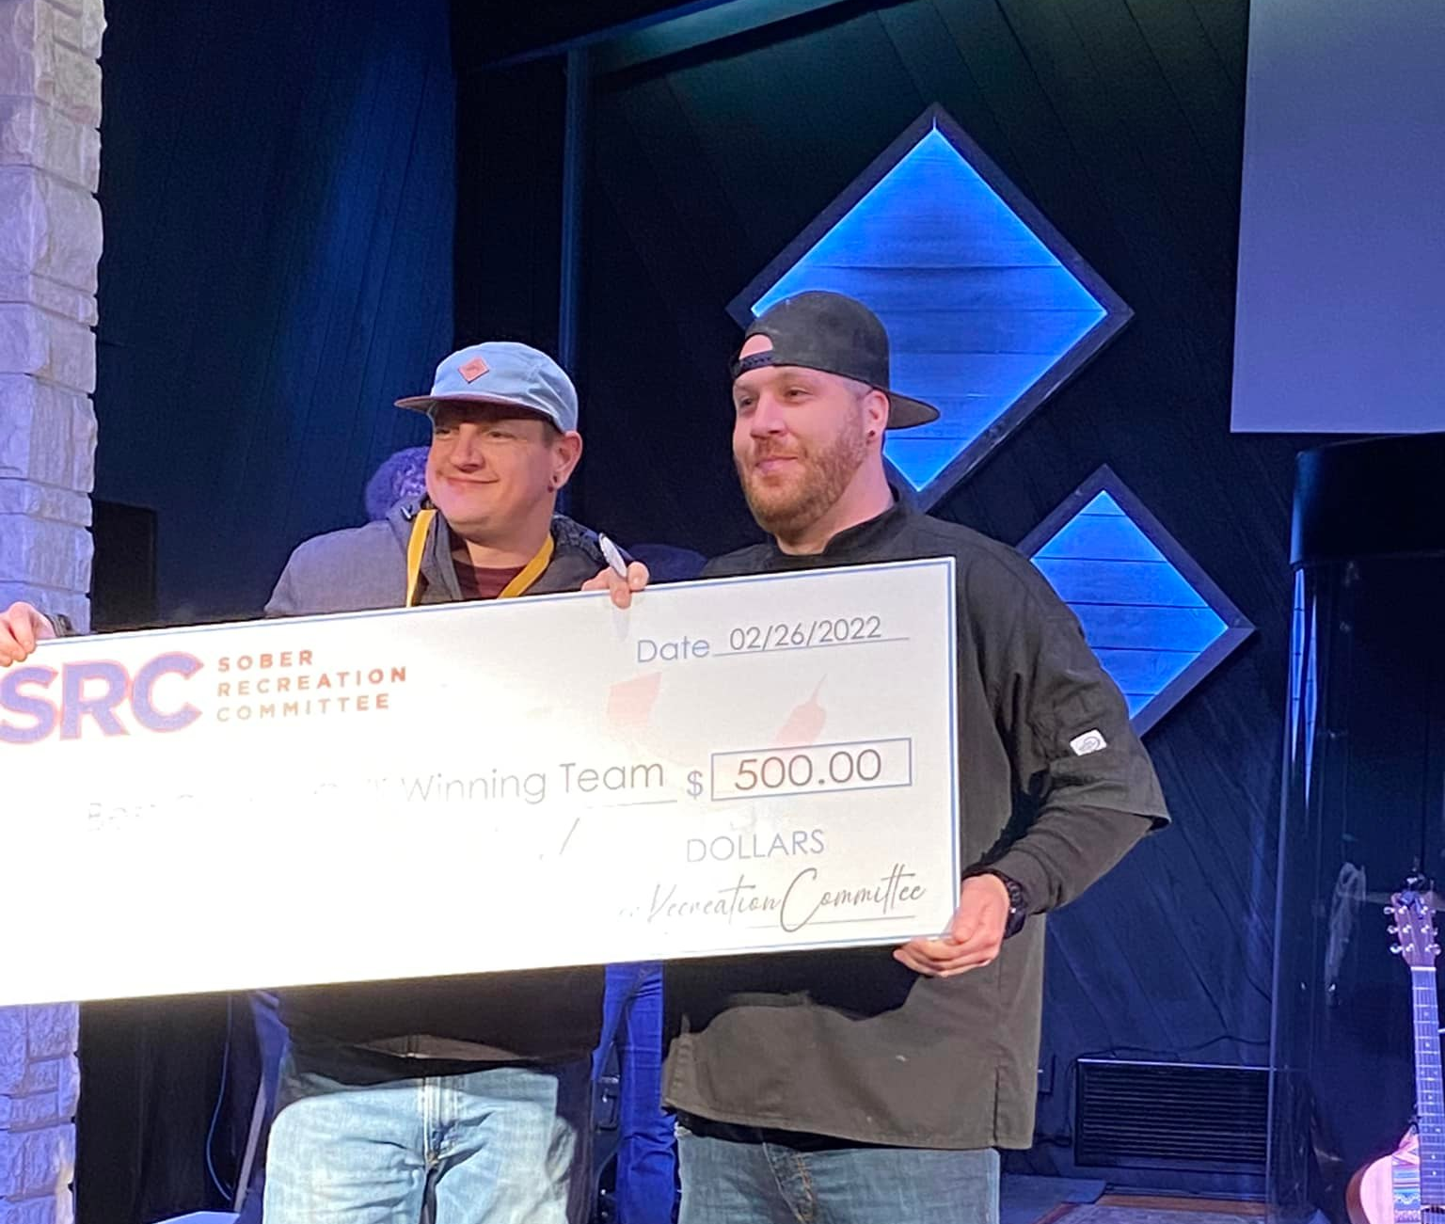
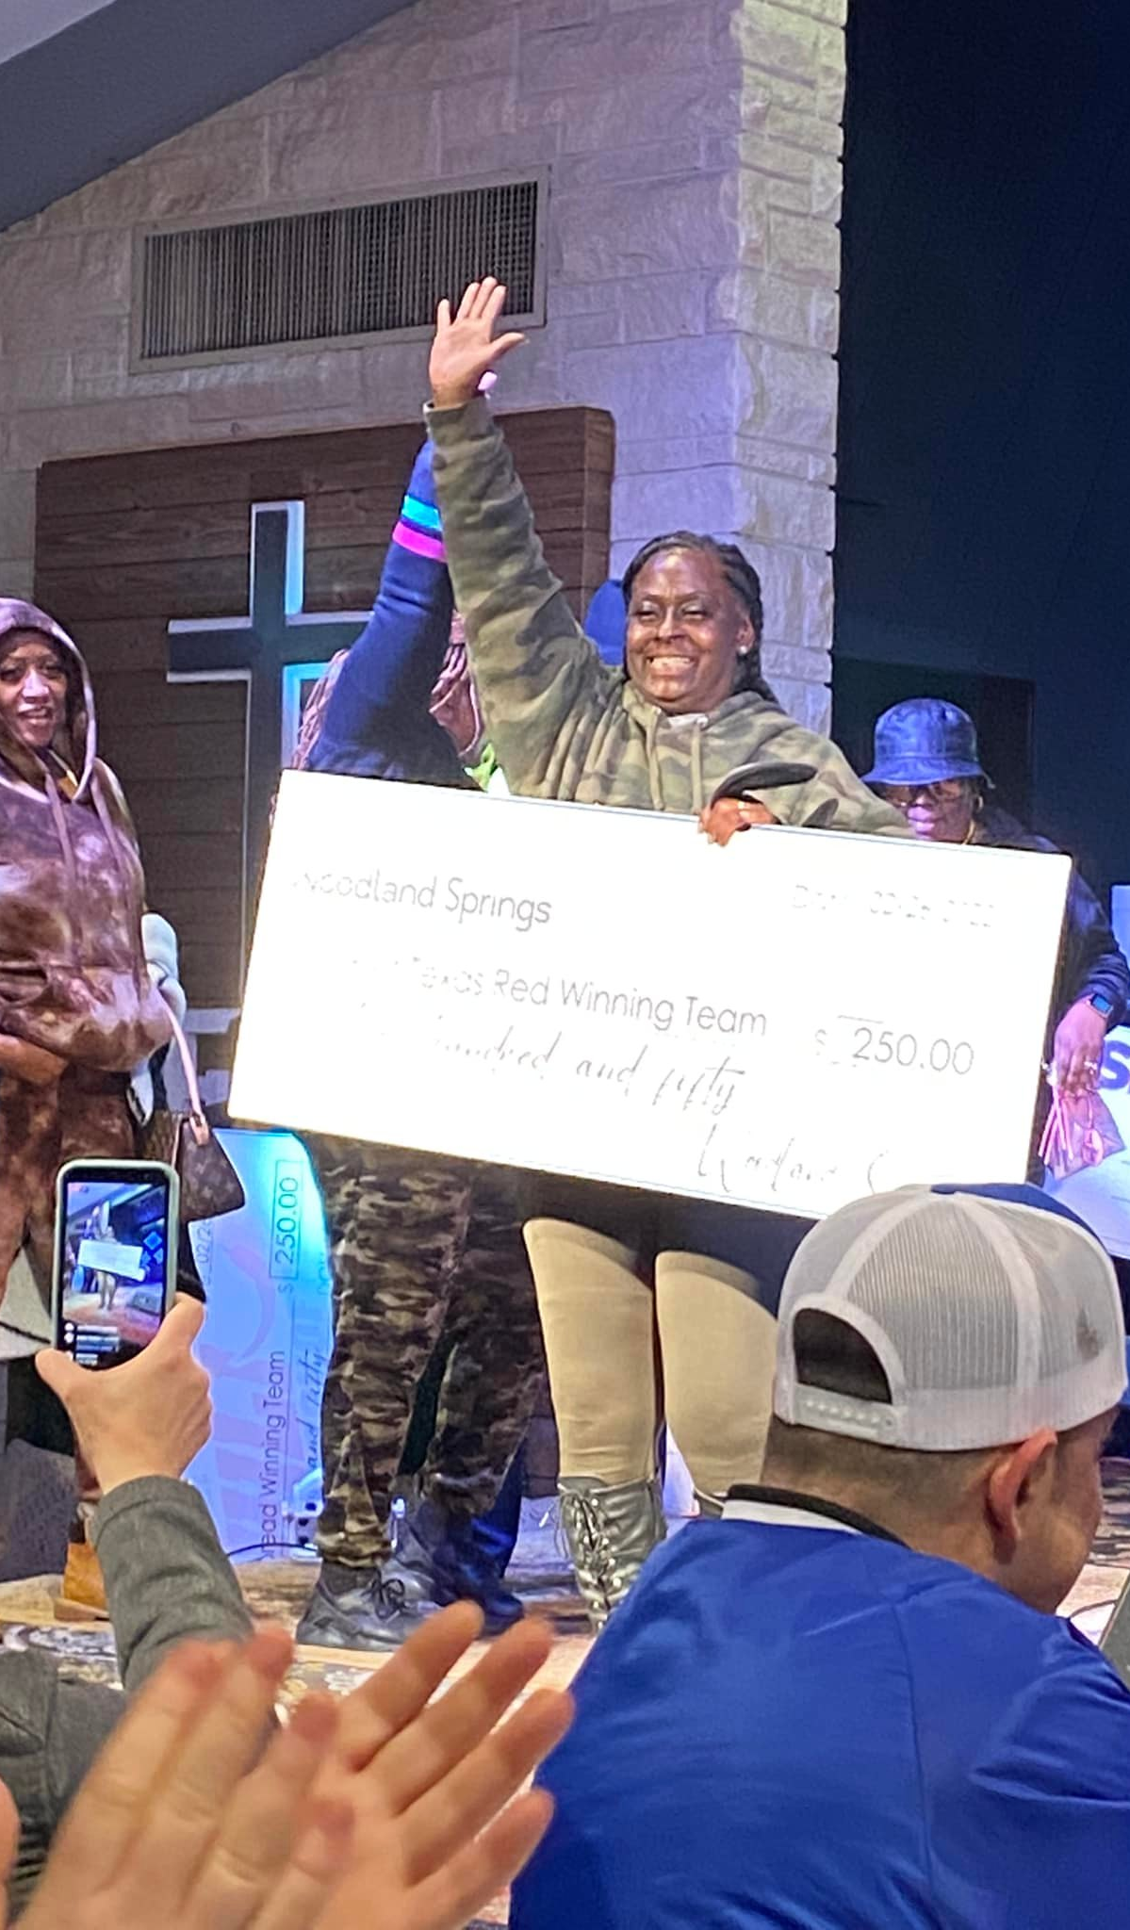
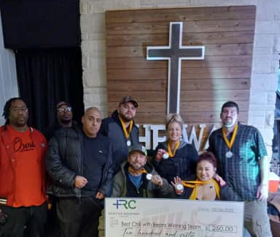
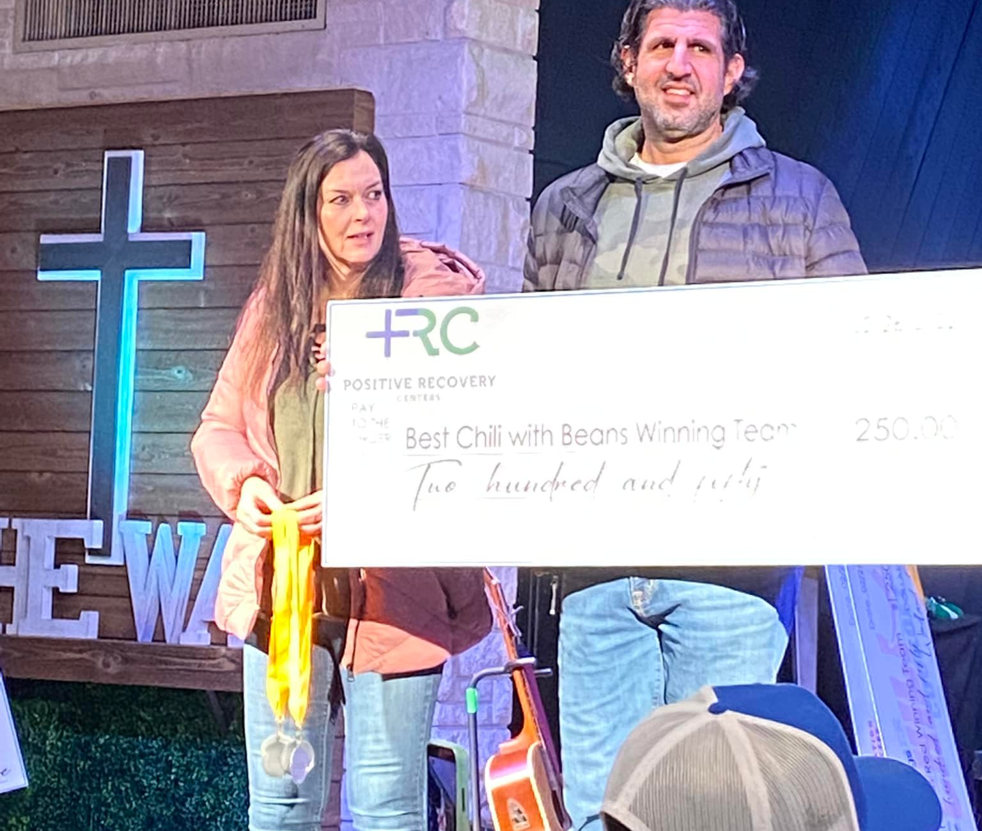
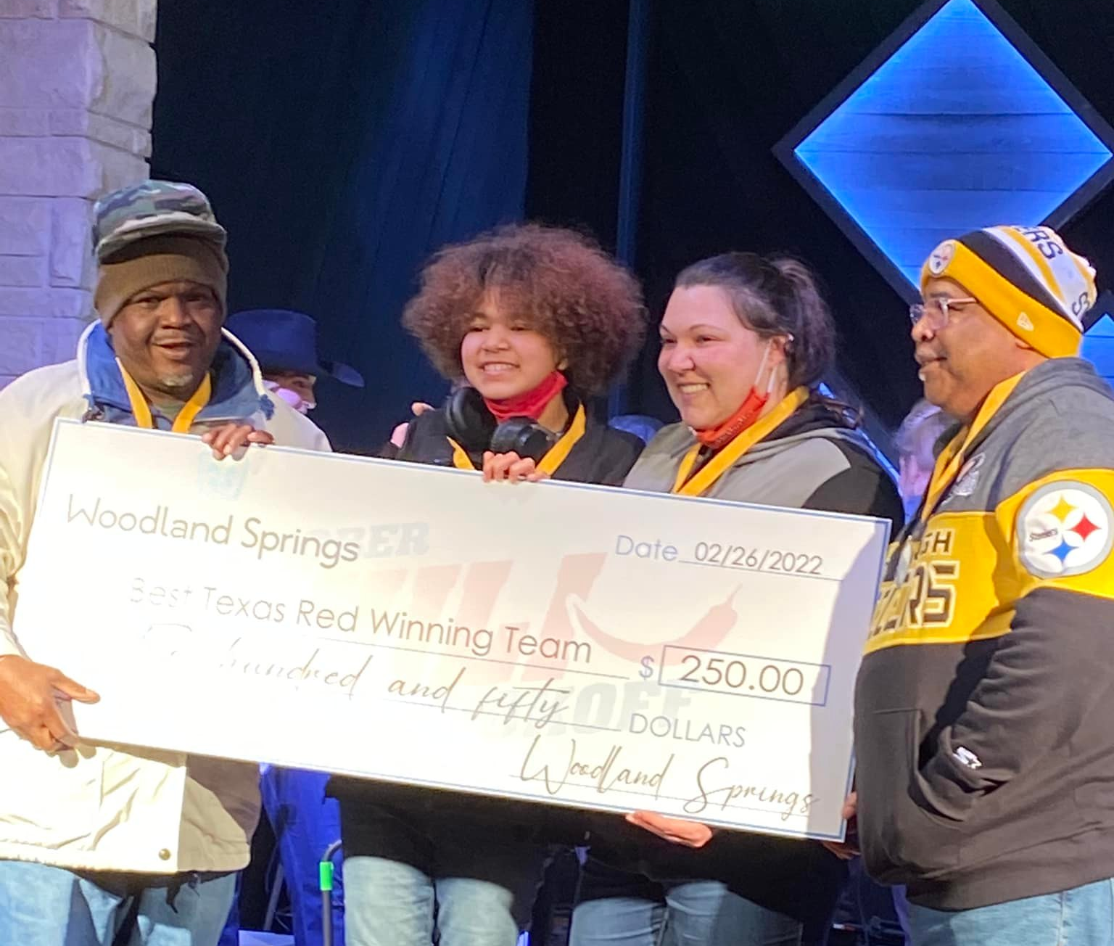

Slide 21

Next PSP Event:

Slide 22
Alumni Outreach Program
The Need
Court Buy In
Volunteers

Slide 23
Growing Justice
Background and Timeline:
January: Judge John Ellisor contacts Justice Forward
March: Board approves exploring expansion
April: Plan developed
May: Board votes unanimously in favor
June: MOUs executed
June-present: Grant proposals submitted

Slide 24
Expansion to Galveston County
Program Director of the H.O.P.E. Drug Court and the Mental Health Court joins the Court Alliance Council
Finances
  Keep separate books
  Open local bank account for funds raised
Advisory Board
  Purpose: to fundraise and educate the community about the effectiveness of Specialty Courts
  Chair attends Houston Board meetings and has voting privileges

Slide 25
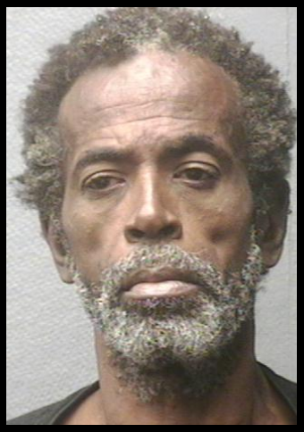
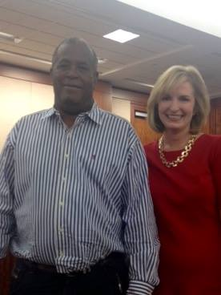
Freddie Johnson

Slide 26
Devon Anderson devon@justiceforwardtx.org
713.899.9893
www.JusticeForwardTX.org

